Slide 1
Python Scientific Calculator
NextHikes IT Solutions
By : VANSHIKA GOEL
Project : Building a GUI-based Scientific Calculator

Slide 2
Project Overview
Build a scientific calculator GUI using Python and Tkinter framework
Support both basic arithmetic and advanced scientific functions
Secure expression evaluation with sandboxed math environment
Keyboard support and calculation history tracking

Slide 3
Essential Features
Basic Operations
Addition, subtraction, multiplication, division, modulus, exponents
Scientific Functions
Trigonometry, logarithms, roots (√, ∛), constants (π, e), factorial

Slide 4
Technology Stack
Language: Python 3.x for core logic and computation
GUI: Tkinter library with ttk for tabbed interface
Libraries: math (functions), re (regex preprocessing)
IDE: Visual Studio Code for development and testing

Slide 5
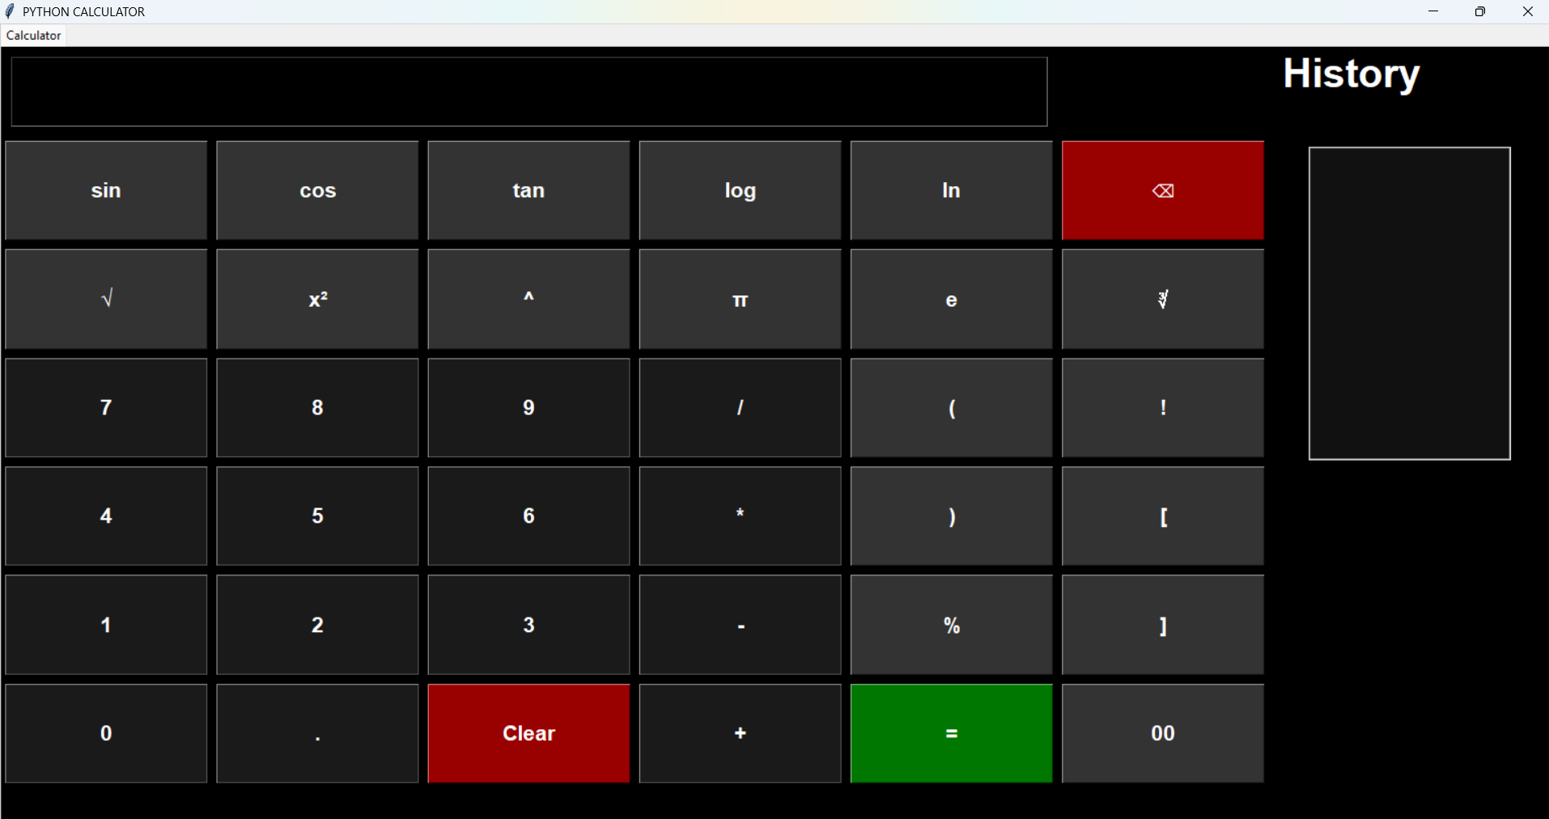

Slide 6
User Interface Design
Window: 1100×520 pixels, resizable to minimum 900×420
Layout: Left calculator keypad, right history panel
Theme: Dark background with white text for better contrast and visibility
Buttons: Large, clickable with visual affordance (green "=", red "Clear")
Responsiveness: Grid-based flexible layout for smooth resizing

Slide 7
Advanced Features
Safe Evaluation: Sandboxed environment blocks arbitrary code execution
Smart Preprocessing: Auto-converts √9 to sqrt(9), 5! to fact(5)
Keyboard Support: Full input support (Enter, Backspace, Escape shortcuts)
History Tracking: Persistent panel auto-scrolls to latest calculation
Intelligent Functions: Context-aware behavior for scientific operations

Slide 8
Code Architecture
Configuration: Window size, colors, fonts, and button dimensions
Safe Math Dictionary: Restricted set of allowed mathematical operations
State Variables: Expression string and history list management
Core Functions: Expression evaluation, factorial handling, smart preprocessing
Event Loop: Tkinter event binding for keyboard and button interactions

Slide 9
Working Application
✓ Fully functional and tested calculator
Features demonstrated:
Real-time expression display and calculation
Scientific keypad with all required operations
Live history panel with calculation records

Slide 10
Recommendations & Enhancements
Add radian/degree toggle for trigonometric functions
Implement memory functions (M+, M-, MR, MC) for efficient calculations
Introduce theme customization and accessibility features
Export calculation history to CSV or PDF format
Add unit conversion tools and programmer mode support

Slide 11
Learning Outcomes
✓ Core Python programming and object-oriented principles
✓ Tkinter GUI framework and event-driven programming
✓ Secure code evaluation and sandboxing techniques
✓ Full-stack application development workflow
Thank You!

